Slide 1
CS 1674: Intro to Computer Vision Grouping: Edges, Lines, Circles, Segments
Prof. Adriana Kovashka University of Pittsburgh
October 2, 2018

Slide 2
Plan for this lecture
Edges
Extract gradients and threshold
Lines and circles
Find which edge points are collinear or belong to another shape e.g. circle
Automatically detect and ignore outliers
Segments
Find which pixels form a consistent region
Clustering (e.g. K-means)

Slide 3
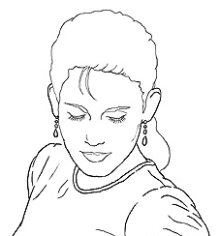
Edge detection
Goal: map image from 2d array of pixels to a set of curves or line segments or contours.
Why?
Main idea: look for strong gradients, post-process
Figure from J. Shotton et al., PAMI 2007
Source: K. Grauman

Slide 4
Designing an edge detector
Criteria for a good edge detector
Good detection: find all real edges, ignoring noise or other artifacts
Good localization
detect edges as close as possible to the true edges
return one point only for each true edge point (true edges = the edges humans drew on an image)
Cues of edge detection
Bottom-up: Differences in color, intensity, or texture across the boundary
Top-down: Continuity and closure, high-level knowledge
Source: L. Fei-Fei

Slide 5
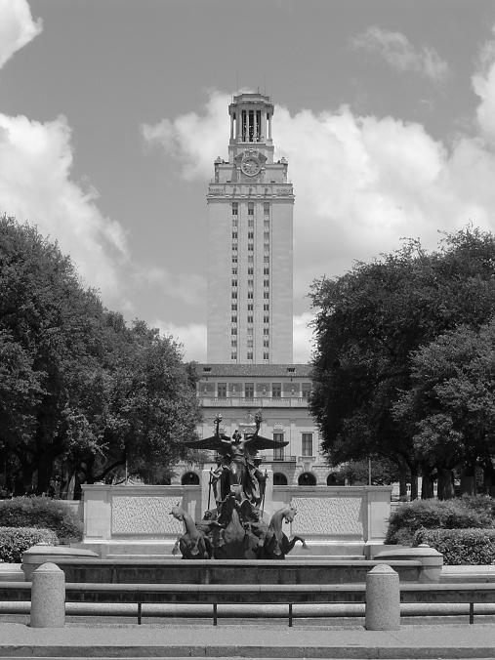
What causes an edge?
Depth discontinuity: object boundary
Reflectance change: appearance information, texture
Cast shadows
Adapted from K. Grauman

Slide 6

Characterizing edges
An edge is a place of rapid change in the image intensity function
intensity function (along horizontal scanline)
image
first derivative
edges correspond to extrema of derivative
Source: L. Lazebnik

Slide 7
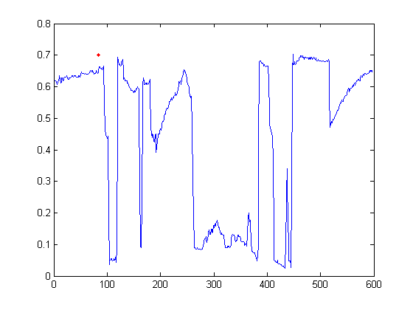
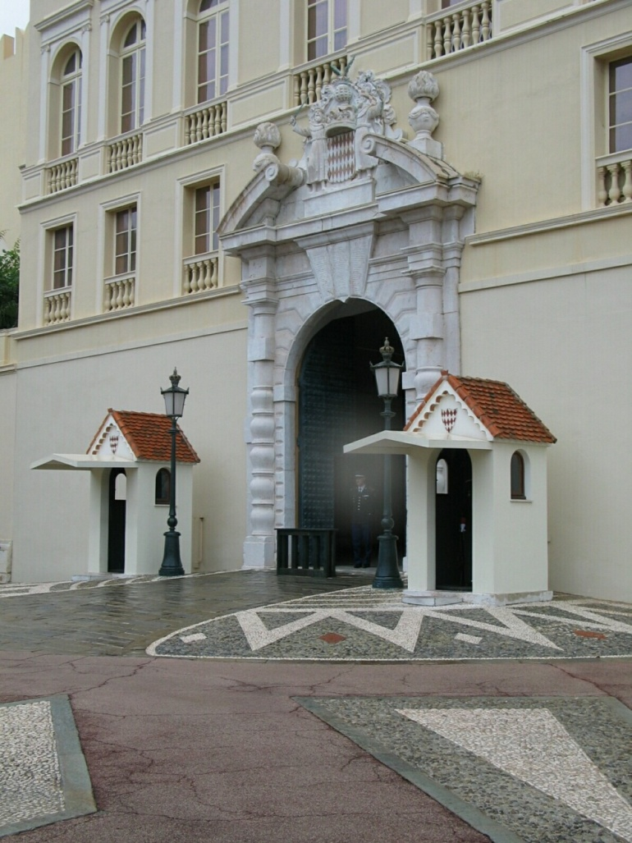
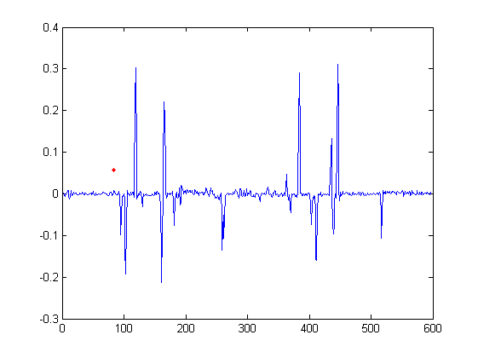
Intensity profile
Intensity
Gradient
Source: D. Hoiem

Slide 8
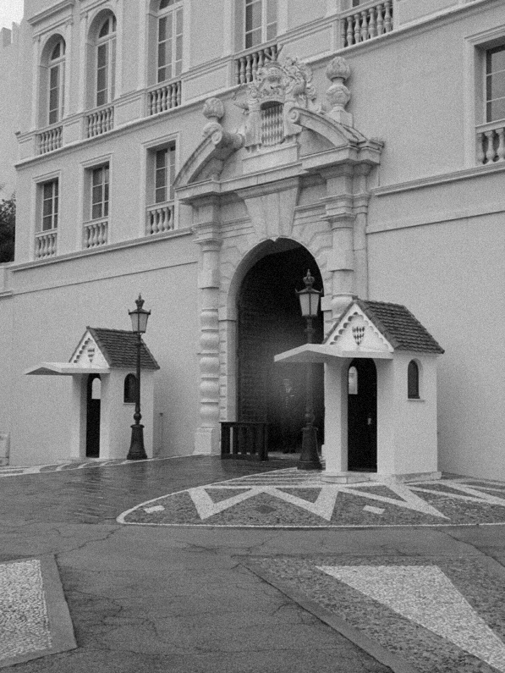
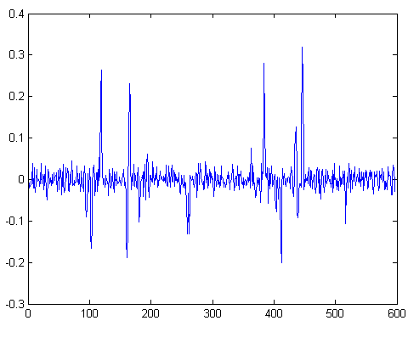
With a little Gaussian noise
Gradient
Source: D. Hoiem

Slide 9
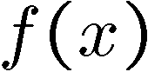
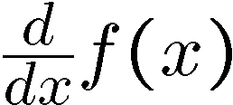
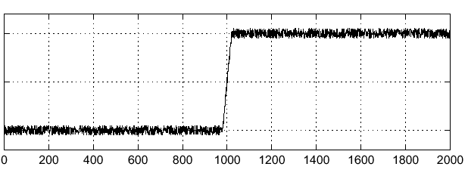
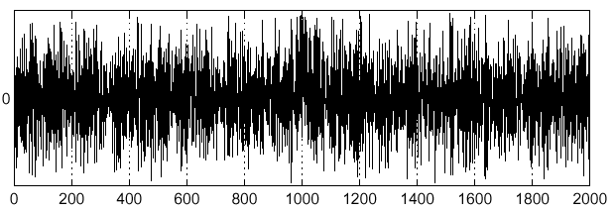
Effects of noise
Consider a single row or column of the image
Plotting intensity as a function of position gives a signal
Where is the edge?
Source: S. Seitz
Notes:
How to fix?

Slide 10
Effects of noise
Difference filters respond strongly to noise
Image noise results in pixels that look very different from their neighbors
Generally, the larger the noise the stronger the response
What can we do about it?
Source: D. Forsyth

Slide 11
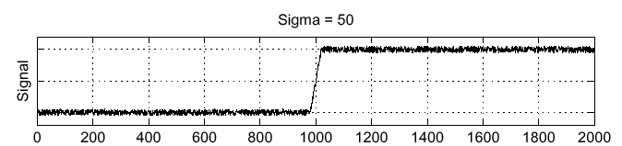
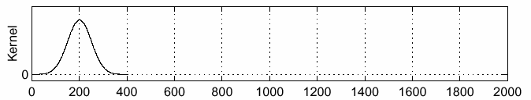
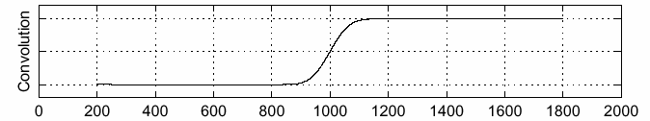
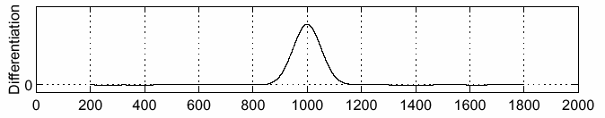
Solution: smooth first
f
g
f * g
To find edges, look for peaks in
Source: S. Seitz

Slide 12
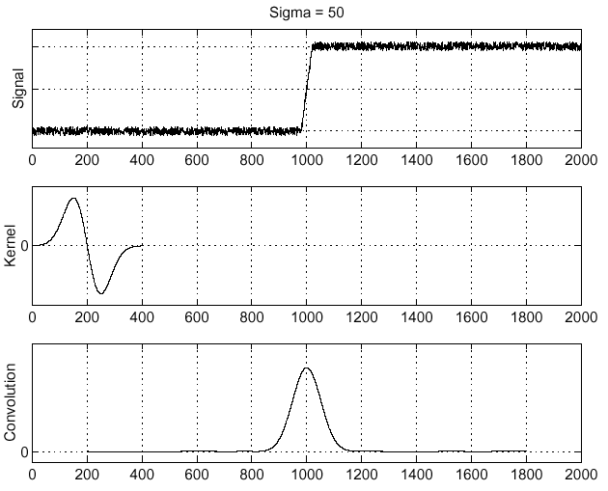
Derivative theorem of convolution
Differentiation is convolution, and convolution is associative:
This saves us one operation:
f
Image
with edge
Derivative of Gaussian
Edge = max of derivative
Source: S. Seitz

Slide 13
Canny edge detector
BREADTH
Filter image with derivative of Gaussian
Find magnitude and orientation of gradient
Threshold: Determine which local maxima from filter output are actually edges
Non-maximum suppression:
Thin wide “ridges” down to single pixel width
Linking and thresholding (hysteresis):
Define two thresholds: low and high
Use the high threshold to start edge curves and the low threshold to continue them
Adapted from K. Grauman, D. Lowe, L. Fei-Fei

Slide 14

Example
input image (“Lena”)

Slide 15
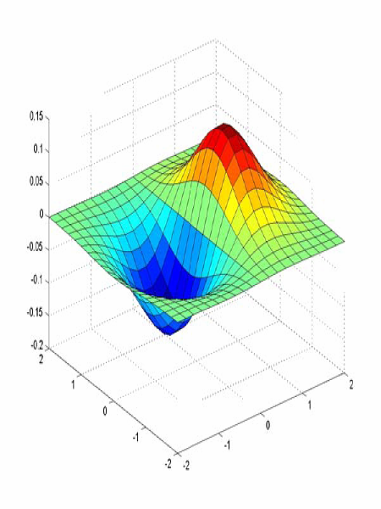
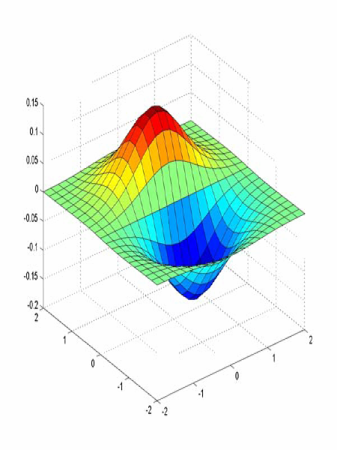
Derivative of Gaussian filter
x-direction
y-direction
Source: L. Lazebnik

Slide 16
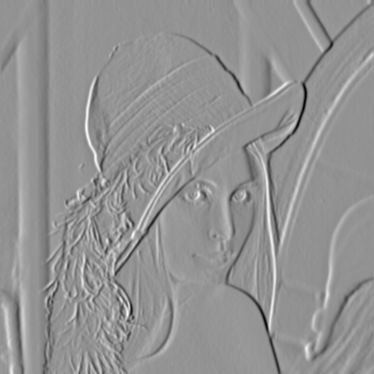
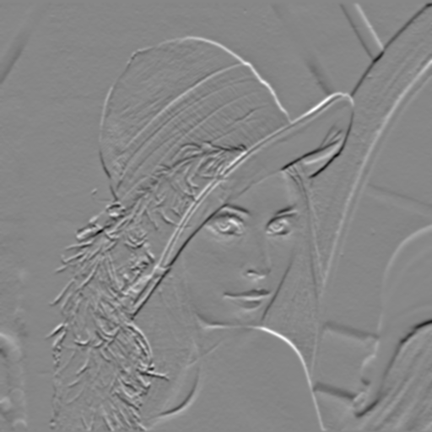
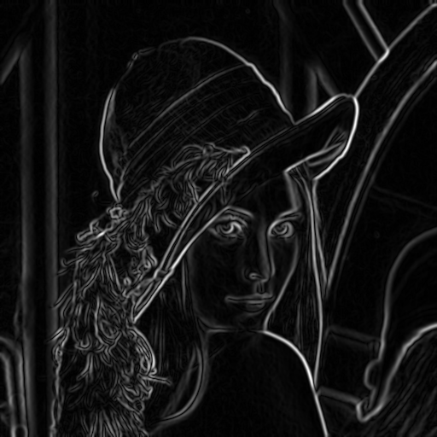
Compute Gradients
X-Derivative of Gaussian
Y-Derivative of Gaussian
Gradient Magnitude
Source: D. Hoiem

Slide 17
Thresholding
Choose a threshold value t
Set any pixels less than t to 0 (off)
Set any pixels greater than or equal to t to 1 (on)
Source: K. Grauman

Slide 18
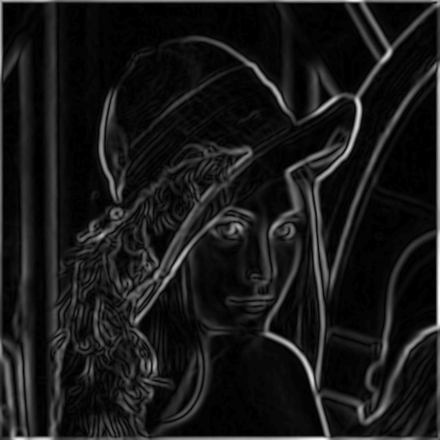
The Canny edge detector
norm of the gradient (magnitude)
Source: K. Grauman

Slide 19
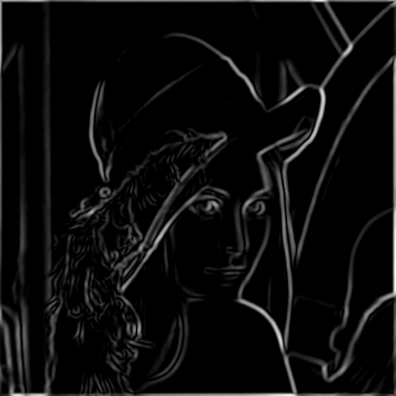
The Canny edge detector
thresholding
Source: K. Grauman

Slide 20
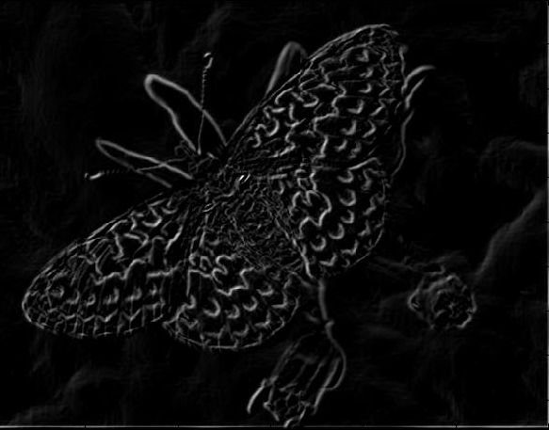
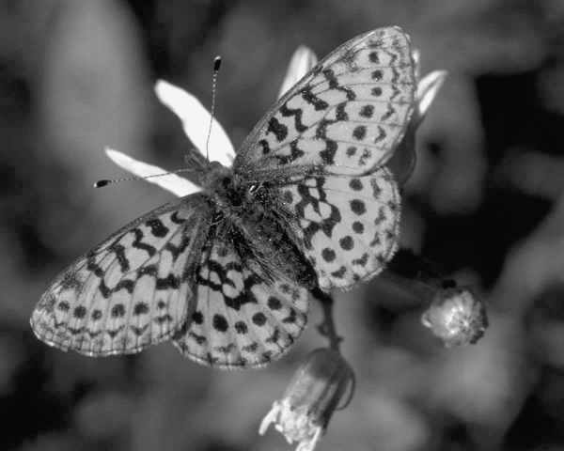
Another example: Gradient magnitudes
Source: K. Grauman

Slide 21
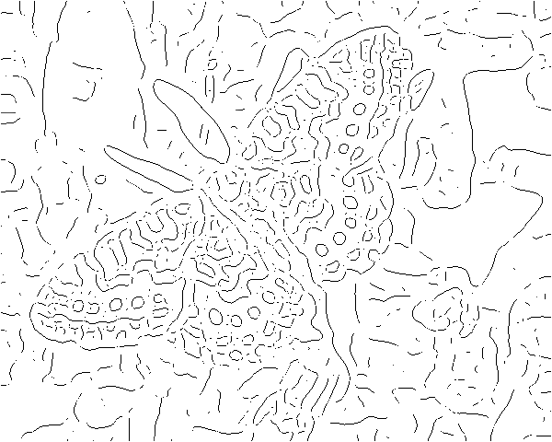
Thresholding gradient with a lower threshold
Source: K. Grauman

Slide 22
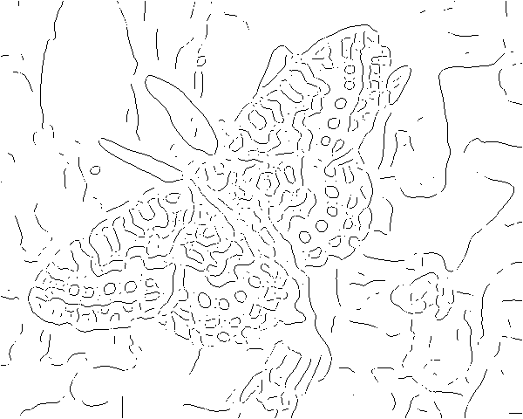
Thresholding gradient with a higher threshold
Source: K. Grauman

Slide 23
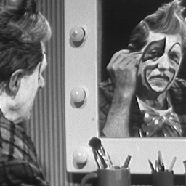
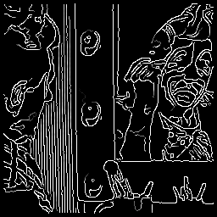
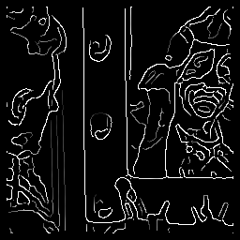
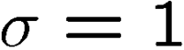

Effect of σ of Gaussian kernel
original
Canny with
Canny with
The choice of σ depends on desired behavior
large σ detects large scale edges
small σ detects fine edges
Source: S. Seitz

Slide 24
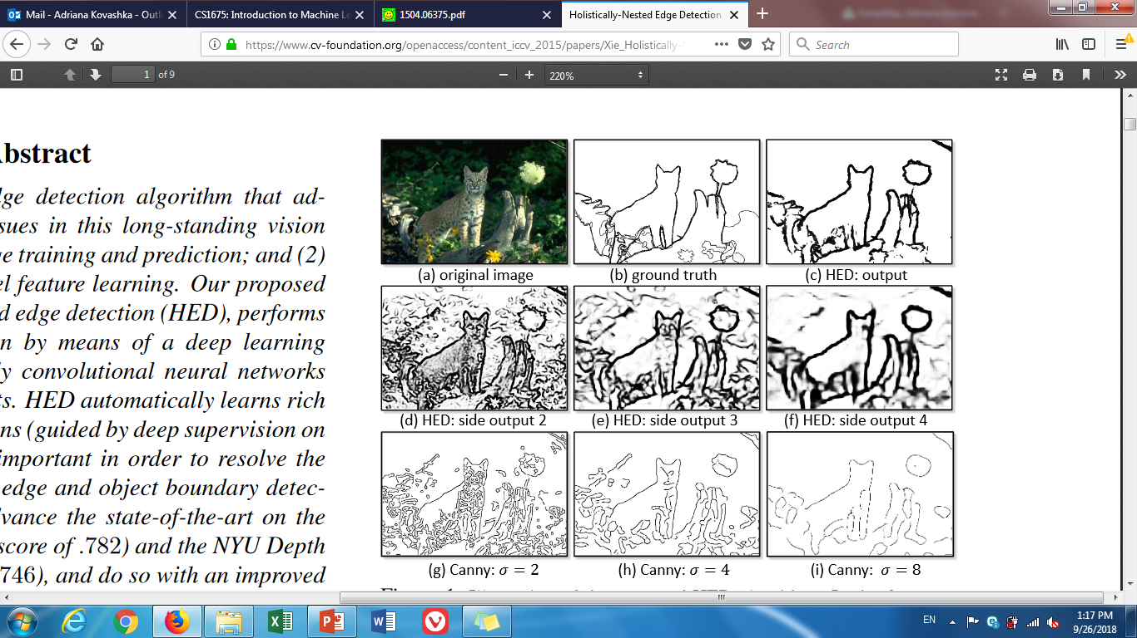
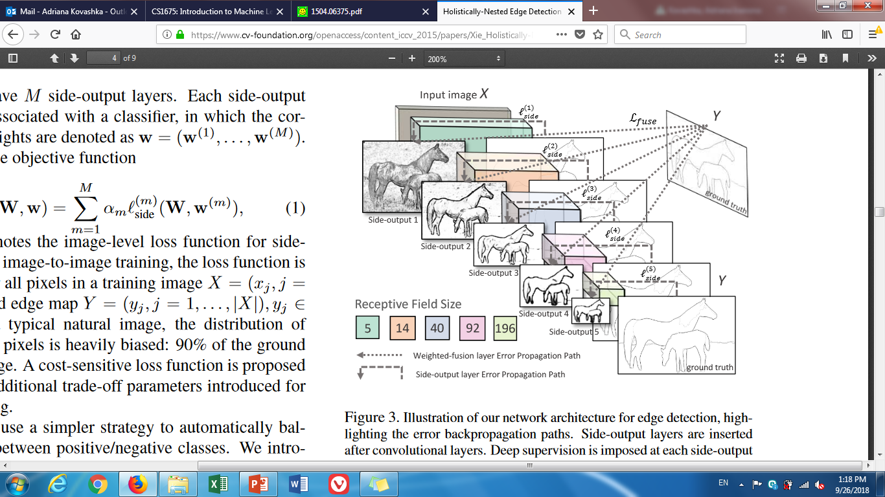
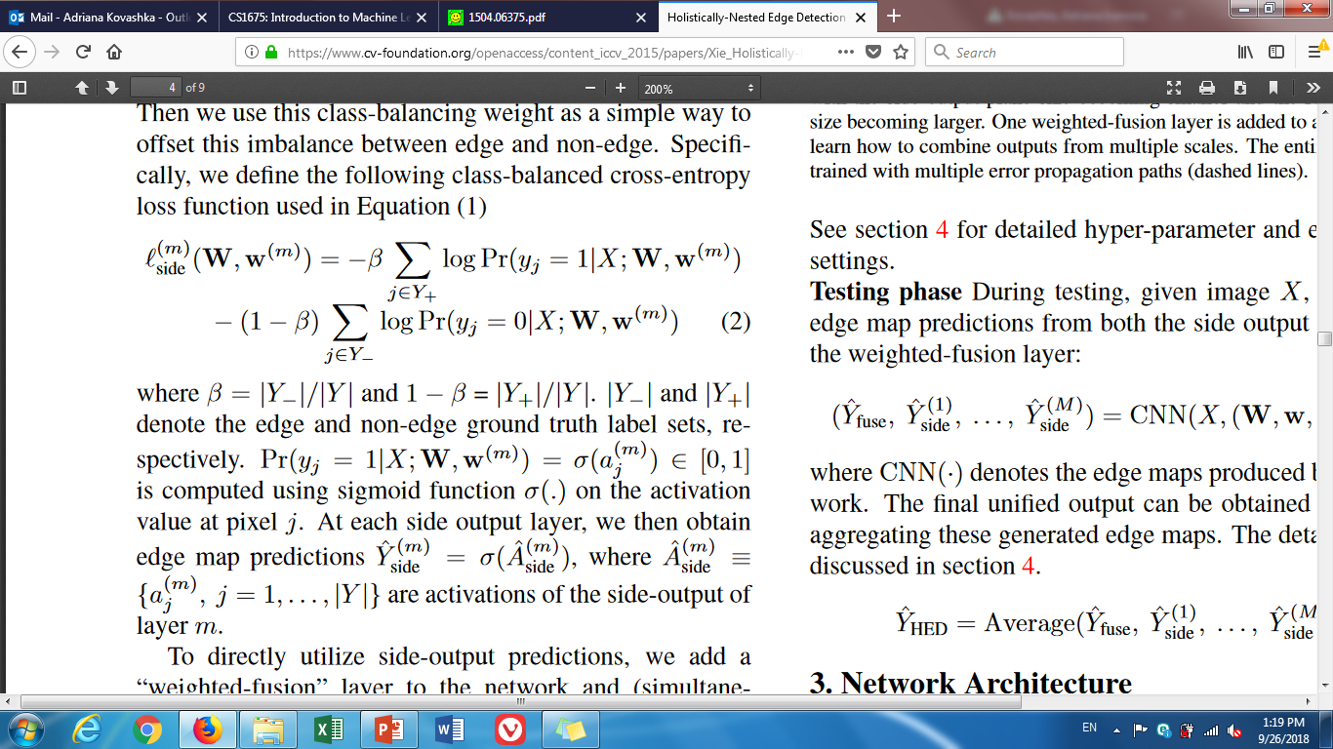
State-of-the-art edge detection: HED
BREADTH
Xie and Tu, “Holistically-Nested Edge Detection”, ICCV 2015

Slide 25
Plan for this lecture
Edges
Extract gradients and threshold
Lines and circles
Find which edge points are collinear or belong to another shape e.g. circle
Automatically detect and ignore outliers
Segments
Find which pixels form a consistent region
Clustering (e.g. K-means)

Slide 26
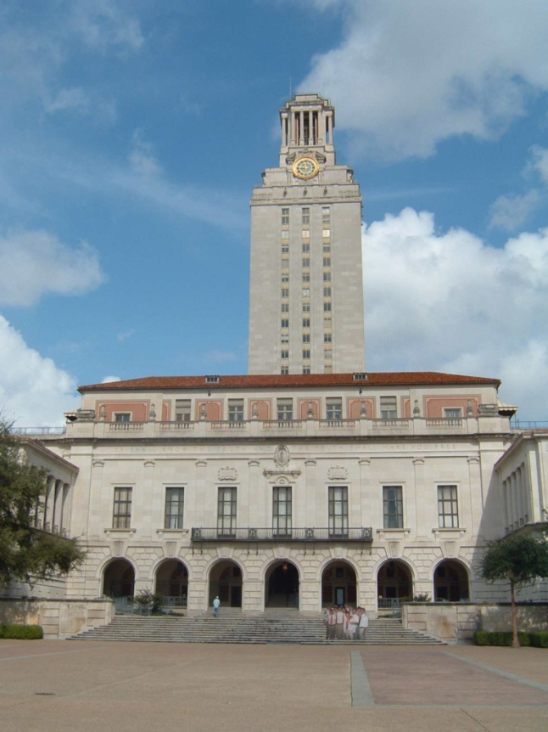
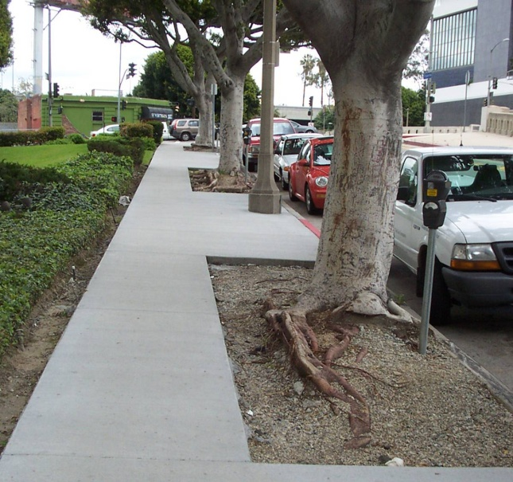
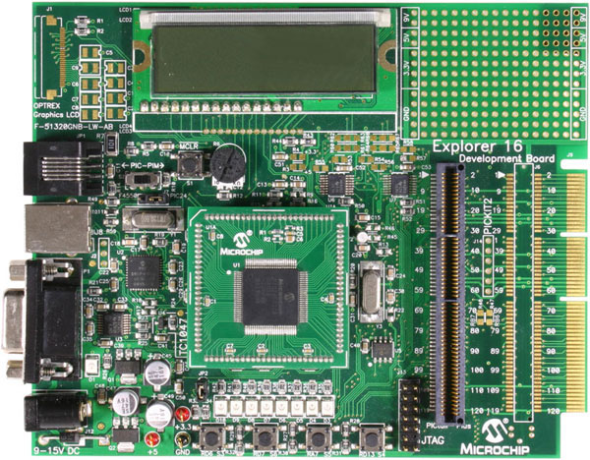
Line detection (fitting)
Why fit lines?
Many objects characterized by presence of straight lines
Why aren’t we done just by running edge detection?
Kristen Grauman

Slide 27
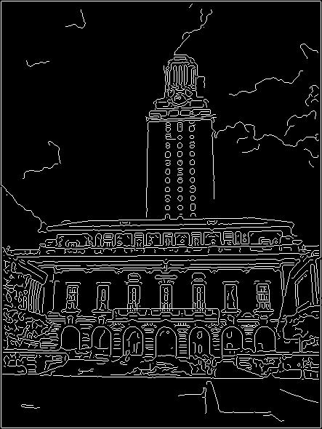
Difficulty of line fitting
Noise in measured edge points, orientations:
e.g. edges not collinear where they should be
how to detect true underlying parameters?
Extra edge points (clutter):
which points go with which line, if any?
Only some parts of each line detected, and some parts are missing:
how to find a line that bridges missing evidence?
Adapted from Kristen Grauman

Slide 28
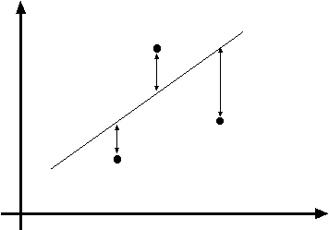
Least squares line fitting
Data: (x₁, y₁), …, (x_{n}, y_{n})
Line equation: y_{i} = m x_{i} + b
Find (m, b) to minimize
y=mx+b
(x_{i}, y_{i})
where line you found tells you point is along y axis
where point really is along y axis
You want to find a single line that “explains” all of the points in your data,
but data may be noisy!
Matlab: p = A \ y; or p = pinv(A)*y;
Adapted from Svetlana Lazebnik

Slide 29
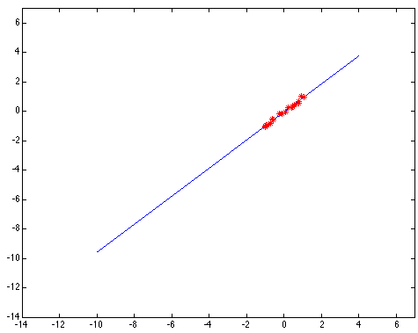
Outliers affect least squares fit
Kristen Grauman
Notes:
29

Slide 30
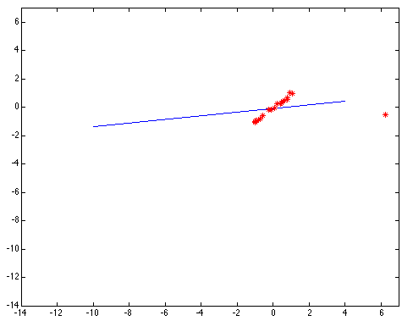
Outliers affect least squares fit
Kristen Grauman
Notes:
30

Slide 31
Dealing with outliers: Voting
Voting is a general technique where we let the features vote for all models that are compatible with it.
Cycle through features, cast votes for model parameters.
Look for model parameters that receive a lot of votes.
Noise & clutter features?
They will cast votes too, but typically their votes should be inconsistent with the majority of “good” features.
Common techniques
Hough transform
RANSAC
Adapted from Kristen Grauman

Slide 32
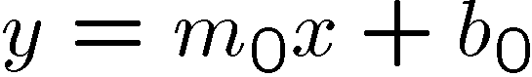
Finding lines in an image: Hough space
y
b
b₀
x
m₀
m
image space
Hough (parameter) space
Connection between image (x,y) and Hough (m,b) spaces
A line in the image corresponds to a point in Hough space
Steve Seitz

Slide 33
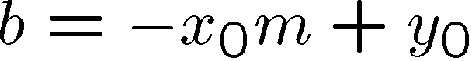
Finding lines in an image: Hough space
y
b
y₀
x₀
x
m
image space
Hough (parameter) space
Connection between image (x,y) and Hough (m,b) spaces
A line in the image corresponds to a point in Hough space
What does a point (x₀, y₀) in the image space map to?
Answer: the solutions of b = -x₀m + y₀
This is a line in Hough space
Given a pair of points (x,y), find all (m,b) such that y = mx + b
Adapted from Steve Seitz

Slide 34
Finding lines in an image: Hough space
y
b
(x₁, y₁)
y₀
(x₀, y₀)
b = –x₁m + y₁
x₀
x
m
image space
Hough (parameter) space
What are the line parameters for the line that contains both (x₀, y₀) and (x₁, y₁)?
It is the intersection of the lines b = –x₀m + y₀ and b = –x₁m + y₁
Steve Seitz

Slide 35
Finding lines in an image: Hough space
y
b
m = 17.5
x
0 5 10 15 20
m
image space
Hough (parameter) space
How can we use this to find the most likely parameters (m,b) for the most prominent line in the image space?
Let each edge point in image space vote for a set of possible parameters in Hough space
Accumulate votes in discrete set of bins; parameters with the most votes indicate line in image space.
Steve Seitz

Slide 36
Finding lines in an image: Hough space
y
m
x
b
y
m
3
5
3
3
2
2
3
7
11
10
4
3
2
3
1
4
5
2
2
1
0
1
3
3
x
b
Adapted from Silvio Savarese

Slide 37
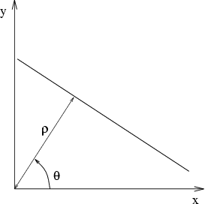
Parameter space representation
Problems with the (m,b) space:
Unbounded parameter domains
Vertical lines require infinite m
Alternative: polar representation
Each point (x,y) will add a sinusoid in the (θ,ρ) parameter space
Svetlana Lazebnik

Slide 38
Parameter space representation
Problems with the (m,b) space:
Unbounded parameter domains
Vertical lines require infinite m
Alternative: polar representation
y
x
Hough space
Each point (x,y) will add a sinusoid in the (θ,ρ) parameter space
Svetlana Lazebnik

Slide 39
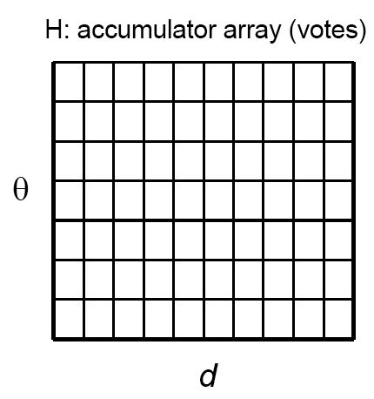
Algorithm outline: Hough transform
Initialize accumulator H to all zeros
For each edge point (x,y) in the image For θ = 0 to 180 ρ = x cos θ + y sin θ H(θ, ρ) = H(θ, ρ) + 1 end end
Find the value(s) of (θ*, ρ*) where H(θ, ρ) is a local maximum
The detected line in the image is given by ρ* = x cos θ* + y sin θ*
ρ
θ
Svetlana Lazebnik

Slide 40


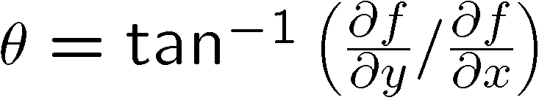
Incorporating image gradients
Recall: when we detect an edge point, we also know its gradient direction
But this means that the line is uniquely determined!
Modified Hough transform:
For each edge point (x,y) in the image
θ = gradient orientation at (x,y) ρ = x cos θ + y sin θ H(θ, ρ) = H(θ, ρ) + 1 end
Svetlana Lazebnik

Slide 41
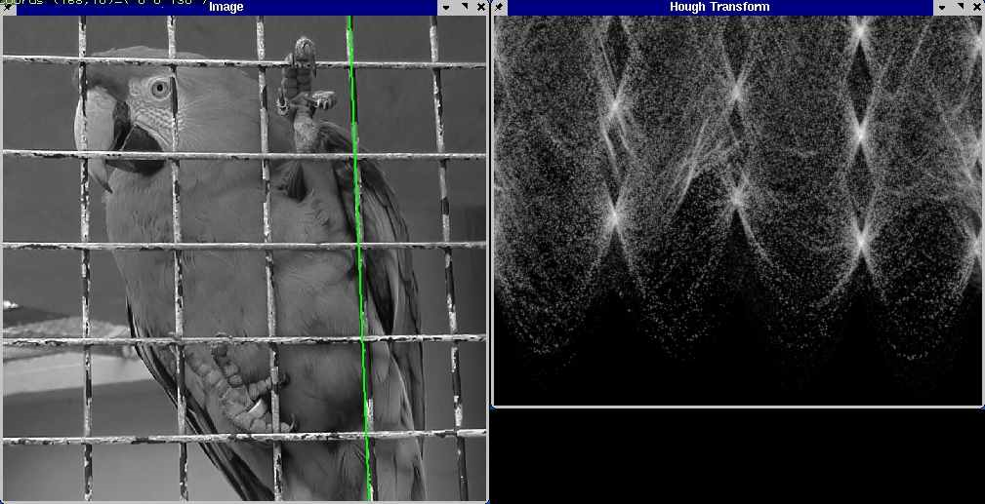
Hough transform example
Derek Hoiem

Slide 42
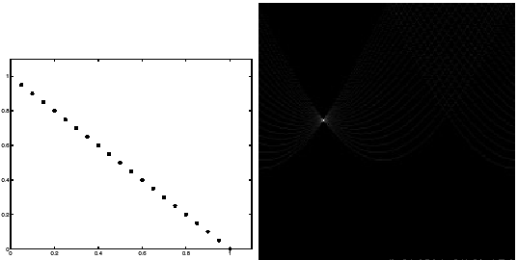
Impact of noise on Hough
y
d
x
θ
Image space
edge coordinates
Votes
Kristen Grauman

Slide 43
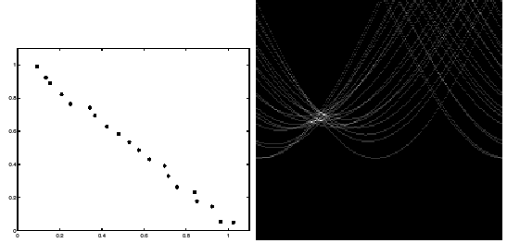
Impact of noise on Hough
y
d
x
θ
Image space
edge coordinates
Votes
What difficulty does this present for an implementation?
Kristen Grauman

Slide 44
Voting: practical tips
Minimize irrelevant tokens first (reduce noise)
Choose a good grid / discretization
Too coarse: large votes obtained when too many different lines correspond to a single bucket
Too fine: miss lines because points that are not exactly collinear cast votes for different buckets
Vote for neighbors (smoothing in accumulator array)
Use direction of edge to reduce parameters by 1
To read back which points voted for “winning” peaks, keep tags on the votes
Too fine
?
Too coarse
Kristen Grauman

Slide 45
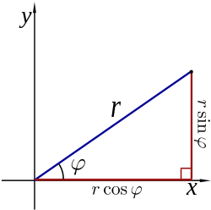
Hough transform for circles
A circle with radius r and center (a, b) can be described as:
x = a + r cos(θ)
y = b + r sin(θ)
(x, y)
ϴ
ϴ
(a, b)
ϴ

Slide 46

Hough transform for circles
Circle: center (a, b) and radius r
For a fixed radius r, unknown gradient direction
Image space
Hough space
Kristen Grauman

Slide 47
Hough transform for circles
Circle: center (a, b) and radius r
For a fixed radius r, unknown gradient direction
Intersection: most votes for center occur here.
Image space
Hough space
Kristen Grauman

Slide 48
Hough transform for circles
x = a + r cos(θ)
y = b + r sin(θ)
For every edge pixel (x,y) :
For each possible radius value r:
For each possible gradient direction θ:
// or use estimated gradient at (x,y)
a = x – r cos(θ) // column
b = y – r sin(θ) // row
H[a,b,r] += 1
end
end
end
x
θ
Your homework!
Modified from Kristen Grauman

Slide 49



Example: detecting circles with Hough
Original
Edges
Votes: Penny
Note: a different Hough transform (with separate accumulators) was used for each circle radius (quarters vs. penny).
Kristen Grauman, images from Vivek Kwatra

Slide 50

Example: detecting circles with Hough
Original
Combined detections
Edges
Votes: Quarter
Note: a different Hough transform (with separate accumulators) was used for each circle radius (quarters vs. penny).
Kristen Grauman, images from Vivek Kwatra

Slide 51
Hough transform: pros and cons
Pros
All points are processed independently, so can cope with occlusion, gaps
Some robustness to noise: noise points unlikely to contribute consistently to any single bin
Can detect multiple instances of a model in a single pass
Cons
Complexity of search time for maxima increases exponentially with the number of model parameters
If 3 parameters and 10 choices for each, search is O(10³)
Quantization: can be tricky to pick a good grid size
Adapted from Kristen Grauman

Slide 52
(Optional) Check hidden slides for:
Generalized Hough transform algorithm
RANSAC (another voting algorithm)
BREADTH

Slide 53
Generalized Hough transform
We want to find a template defined by its reference point (center) and several distinct types of landmark points in stable spatial configuration
Template
Triangle, circle, diamond:
some type of visual token,
e.g. feature or edge point
c
Adapted from Svetlana Lazebnik

Slide 54
Generalized Hough transform
Intuition:
Displacement vectors
x
x
x
Ref. point
x
x
Model image
Novel image
Vote space
Now suppose those colors encode gradient directions…
Adapted from Kristen Grauman

Slide 55
Generalized Hough transform
Define a model shape by its boundary points and a reference point.
Offline procedure:
x
a
At each boundary point, compute displacement vector: r = a – p_{i}.
Store these vectors in a table indexed by gradient orientation θ.
θ
θ
p₁
p₂
Model shape
θ
…
θ
…
…
Kristen Grauman
[Dana H. Ballard, Generalizing the Hough Transform to Detect Arbitrary Shapes, 1980]

Slide 56
Generalized Hough transform
Detection procedure:
x
For each edge point:
Use its gradient orientation θ to index into stored table
Use retrieved r vectors to vote for reference point
x
θ
x
x
x
θ
θ
p₁
θ
θ
Novel image
θ
…
Assuming translation is the only transformation here, i.e., orientation and scale are fixed.
θ
…
…
Kristen Grauman

Slide 57
Generalized Hough transform
Template representation
For each type of landmark point, store all possible displacement vectors towards the center
Model
Template
Svetlana Lazebnik

Slide 58
Generalized Hough transform
Detecting the template
For each feature in a new image, look up that feature type in the model and vote for the possible center locations associated with that type in the model
Model
Test image
Svetlana Lazebnik
Notes:
Note that some of the features present in the template may actually be absent in the test image. The positions of the features can move around; new “noise” or “clutter” features can be added.
The small circles represent votes for possible center location.

Slide 59

Preview: Hough for object detection
Index displacements by “visual codeword”
“visual codeword” with displacement vectors
training image
B. Leibe, A. Leonardis, and B. Schiele, Combined Object Categorization and Segmentation with an Implicit Shape Model, ECCV Workshop on Statistical Learning in Computer Vision 2004
Svetlana Lazebnik

Slide 60
RANSAC
RANdom Sample Consensus
Approach: we want to avoid the impact of outliers, so let’s look for “inliers”, and use those only.
Intuition: if an outlier is chosen to compute the current fit, then the resulting line won’t have much support from rest of the points.
Kristen Grauman

Slide 61
RANSAC: General form
RANSAC loop:
Randomly select a seed group of s points on which to base model estimate (e.g. s=2 for a line)
Fit model to these s points
Find inliers to this model (i.e., points whose distance from the line is less than t)
Repeat N times
Keep the model with the largest number of inliers
Adapted from Kristen Grauman and Svetlana Lazebnik

Slide 62
RANSAC
_{(RANdom SAmple Consensus) :}
Fischler & Bolles in ‘81.
Line fitting example
Algorithm:
Sample (randomly) the number of points required to fit the model
Solve for model parameters using samples
Score by the fraction of inliers within a preset threshold of the model
Repeat 1-3 until the best model is found with high confidence
Silvio Savarese
Notes:
Let me give you an intuition of what is going on. Suppose we have the standard line fitting problem in presence of outliers.
We can formulate this problem as follows: want to find the best partition of points in inlier set and outlier set such that…
The objective consists of adjusting the parameters of a model function so as to best fit a data set.
"best" is defined by a function f that needs to be minimized.
Such that the best parameter of fitting the line give rise to a residual error lower that delta
as when the sum, S, of squared residuals

Slide 63
RANSAC
_{(RANdom SAmple Consensus) :}
Fischler & Bolles in ‘81.
Line fitting example
Algorithm:
Sample (randomly) the number of points required to fit the model (#=2)
Solve for model parameters using samples
Score by the fraction of inliers within a preset threshold of the model
Repeat 1-3 until the best model is found with high confidence
Silvio Savarese
Notes:
Let me give you an intuition of what is going on. Suppose we have the standard line fitting problem in presence of outliers.
We can formulate this problem as follows: want to find the best partition of points in inlier set and outlier set such that…
The objective consists of adjusting the parameters of a model function so as to best fit a data set.
"best" is defined by a function f that needs to be minimized.
Such that the best parameter of fitting the line give rise to a residual error lower that delta
as when the sum, S, of squared residuals

Slide 64
RANSAC
_{(RANdom SAmple Consensus) :}
Fischler & Bolles in ‘81.
Line fitting example
Algorithm:
Sample (randomly) the number of points required to fit the model (#=2)
Solve for model parameters using samples
Score by the fraction of inliers within a preset threshold of the model
Repeat 1-3 until the best model is found with high confidence
Silvio Savarese
Notes:
Let me give you an intuition of what is going on. Suppose we have the standard line fitting problem in presence of outliers.
We can formulate this problem as follows: want to find the best partition of points in inlier set and outlier set such that…
The objective consists of adjusting the parameters of a model function so as to best fit a data set.
"best" is defined by a function f that needs to be minimized.
Such that the best parameter of fitting the line give rise to a residual error lower that delta
as when the sum, S, of squared residuals

Slide 65
RANSAC
_{(RANdom SAmple Consensus) :}
Fischler & Bolles in ‘81.
Line fitting example
Algorithm:
Sample (randomly) the number of points required to fit the model (#=2)
Solve for model parameters using samples
Score by the fraction of inliers within a preset threshold of the model
Repeat 1-3 until the best model is found with high confidence
Silvio Savarese
Notes:
Let me give you an intuition of what is going on. Suppose we have the standard line fitting problem in presence of outliers.
We can formulate this problem as follows: want to find the best partition of points in inlier set and outlier set such that…
The objective consists of adjusting the parameters of a model function so as to best fit a data set.
"best" is defined by a function f that needs to be minimized.
Such that the best parameter of fitting the line give rise to a residual error lower that delta
as when the sum, S, of squared residuals

Slide 66
RANSAC
_{(RANdom SAmple Consensus) :}
Fischler & Bolles in ‘81.
Line fitting example
Algorithm:
Sample (randomly) the number of points required to fit the model (#=2)
Solve for model parameters using samples
Score by the fraction of inliers within a preset threshold of the model
Repeat 1-3 until the best model is found with high confidence
Silvio Savarese
Notes:
Let me give you an intuition of what is going on. Suppose we have the standard line fitting problem in presence of outliers.
We can formulate this problem as follows: want to find the best partition of points in inlier set and outlier set such that…
The objective consists of adjusting the parameters of a model function so as to best fit a data set.
"best" is defined by a function f that needs to be minimized.
Such that the best parameter of fitting the line give rise to a residual error lower that delta
as when the sum, S, of squared residuals

Slide 67
How to choose parameters?
Number of samples N
Choose N so that, with probability p, at least one random sample is free from outliers (e.g. p=0.99) (outlier ratio: e )
Number of sampled points s
Minimum number needed to fit the model
Distance threshold δ
Choose δ so that a good point with noise is likely (e.g., prob=0.95) within threshold
E.g. for zero-mean Gaussian noise with std. dev. σ: δ ² = 3.84σ²
 | proportion of outliers e
s | 5% | 10% | 20% | 25% | 30% | 40% | 50%
2 | 2 | 3 | 5 | 6 | 7 | 11 | 17
3 | 3 | 4 | 7 | 9 | 11 | 19 | 35
4 | 3 | 5 | 9 | 13 | 17 | 34 | 72
5 | 4 | 6 | 12 | 17 | 26 | 57 | 146
6 | 4 | 7 | 16 | 24 | 37 | 97 | 293
7 | 4 | 8 | 20 | 33 | 54 | 163 | 588
8 | 5 | 9 | 26 | 44 | 78 | 272 | 1177
Explanation in Szeliski 6.1.4
Marc Pollefeys and Derek Hoiem

Slide 68
RANSAC pros and cons
Pros
Applicable to many different problems, e.g. image stitching, relating two views
Often works well in practice
Cons
Lots of parameters to tune (see previous slide)
Doesn’t work well for low inlier ratios (too many iterations, or can fail completely)
Adapted from Svetlana Lazebnik

Slide 69
Plan for today
Edges
Extract gradients and threshold
Lines and circles
Find which edge points are collinear or belong to another shape e.g. circle
Automatically detect and ignore outliers
Segments
Find which pixels form a consistent region
Clustering (e.g. K-means)

Slide 70

Edges vs Segments
Edges: More low-level; don’t need to be closed
Segments: Ideally one segment for each semantic group/object; should include closed contours
Figure adapted from J. Hays

Slide 71




The goals of segmentation
Separate image into coherent “objects”
image
human segmentation
Source: L. Lazebnik

Slide 72


The goals of segmentation
Separate image into coherent “objects”
Group together similar-looking pixels for efficiency of further processing
“superpixels”
X. Ren and J. Malik. Learning a classification model for segmentation. ICCV 2003.
Source: L. Lazebnik

Slide 73


We perceive the interpretation
The Muller-Lyer illusion
Adapted from K. Grauman, D. Hoiem
Notes:
Gestalt (psychology): Whole is greater than sum of its parts. Relationships among parts yield additional information.
The famous Muller-Lyer illusion: the point is that the horizontal bar has properties that come only from its membership in a group (it looks shorter in the lower picture, but is actually the same size) and that these properties can’t be discounted--- you can’t look at this figure and ignore the arrowheads and thereby make the two bars seem to be the same size.

Slide 74




Similarity
Slide: K. Grauman

Slide 75


Proximity
Slide: K. Grauman

Slide 76


Common fate
Slide: K. Grauman

Slide 77


Image segmentation: toy example
white pixels
pixel count
3
black pixels
gray pixels
1
2
input image
intensity
These intensities define the three groups.
We could label every pixel in the image according to which of these primary intensities it is.
i.e., segment the image based on the intensity feature.
What if the image isn’t quite so simple?
Source: K. Grauman

Slide 78


pixel count
input image
intensity
Now how to determine the three main intensities that define our groups?
We need to cluster.
Source: K. Grauman

Slide 79

0
190
255
intensity
3
1
2
Goal: choose three “centers” as the representative intensities, and label every pixel according to which of these centers it is nearest to.
Best cluster centers are those that minimize sum of squared differences (SSD) between all points and their nearest cluster center ci:
Source: K. Grauman

Slide 80
Clustering
With this objective, it is a “chicken and egg” problem:
If we knew the cluster centers, we could allocate points to groups by assigning each to its closest center.
If we knew the group memberships, we could get the centers by computing the mean per group.
Source: K. Grauman

Slide 81

K-means clustering
Basic idea: randomly initialize the k cluster centers, and iterate between the two steps we just saw.
Randomly initialize the cluster centers, c₁, ..., c_{K}
Given cluster centers, determine points in each cluster
For each point p, find the closest c_{i}. Put p into cluster i
Given points in each cluster, solve for c_{i}
Set c_{i} to be the mean of points in cluster i
If c_{i} have changed, repeat Step 2
Properties
Will always converge to some solution
Can be a “local minimum” of objective:
Slide: Steve Seitz, image: Wikipedia

Slide 82

Source: A. Moore

Slide 83

Source: A. Moore

Slide 84

Source: A. Moore

Slide 85

Source: A. Moore

Slide 86

Source: A. Moore

Slide 87

K-means converges to a local minimum
How can I try to fix this problem?
Adapted from James Hays

Slide 88


K-means: pros and cons
Pros
Simple, fast to compute
Converges to local minimum of within-cluster squared error
Cons/issues
Setting k?
One way: silhouette coefficient
Sensitive to initial centers
Use heuristics or output of another method
Sensitive to outliers
Detects spherical clusters
Adapted from K. Grauman
Notes:
88

Slide 89

An aside: Smoothing out cluster assignments
Assigning a cluster label per pixel may yield outliers:
original
labeled by cluster center’s intensity
?
How to ensure they are spatially smooth?
3
1
2
Source: K. Grauman

Slide 90

Segmentation as clustering
Depending on what we choose as the feature space, we can group pixels in different ways.
Grouping pixels based on intensity similarity
Feature space: intensity value (1-d)
Source: K. Grauman
Notes:
90

Slide 91


K=2
K=3
Adapted from K. Grauman

Slide 92
Segmentation as clustering
Depending on what we choose as the feature space, we can group pixels in different ways.
Grouping pixels based on intensity similarity
Clusters based on intensity similarity don’t have to be spatially coherent.
Source: K. Grauman
Notes:
92

Slide 93
Segmentation as clustering
Depending on what we choose as the feature space, we can group pixels in different ways.
Grouping pixels based
on intensity+position similarity
Intensity
Y
X
Both regions are black, but if we also include position (x,y), then we could group the two into distinct segments; way to encode both similarity & proximity.
Source: K. Grauman
Notes:
93

Slide 94

Segmentation as clustering
Depending on what we choose as the feature space, we can group pixels in different ways.
R=255
G=200
B=250
Grouping pixels based on color similarity
B
R=245
G=220
B=248
G
R=15
G=189
B=2
R=3
G=12
B=2
R
Feature space: color value (3-d)
Source: K. Grauman
Notes:
94

Slide 95



Segmentation as clustering
Color, brightness, position alone are not enough to distinguish all regions…
Source: L. Lazebnik

Slide 96

Segmentation as clustering
Depending on what we choose as the feature space, we can group pixels in different ways.
Grouping pixels based on texture similarity
F₁
F₂
Filter bank of 24 filters
…
F₂₄
Feature space: filter bank responses (e.g., 24-d)
Source: K. Grauman
Notes:
96

Slide 97


Segmentation w/ texture features
Find “textons” by clustering filter bank response vectors
Describe texture in a window as bag of words over textures
Count
Image
Texton map
Texton index
Count
Count
Texton index
Texton index
Malik, Belongie, Leung and Shi, IJCV 2001
Adapted from L. Lazebnik

Slide 98




State-of-the-art (instance) segmentation: Mask R-CNN
Classification Scores: C
Box coordinates (per class): 4 * C
CNN
Conv
Conv
RoI Align
Predict a mask for each of C classes
May 10, 2017
He et al, “Mask R-CNN”, ICCV 2017; slide adapted from Justin Johnson

Slide 99
Summary: classic approaches
Edges: threshold gradient magnitude
Lines: edge points vote for parameters of line, circle, etc. (works for general objects)
Segments: use clustering (e.g. K-means) to group pixels by intensity, texture, etc.

